Slide 1


FLIGHT RISK
Predictive Intelligence for Disruptive Travel

Slide 2

THE CHALLENGE
Understanding the friction in modern aviation data and the cost of traveler uncertainty.

Slide 3

THE "BLIND PURCHASE" PROBLEM
Travelers currently face a significant information gap. Without the ability to assess the specific risk of delays or cancellations, decisions are made blindly.
This lack of transparency is critical for:
High-stakes business travel requirements
Precise insurance underwriting decisions
Mitigating the high cost of disruptions

Slide 4



THE DATA ACCESSIBILITY GAP
The Barrier
Reliable flight data is often locked behind prohibitively expensive enterprise APIs or restricted to basic airport-level reporting.
The Opportunity
Advanced Data Science enables us to build predictive models using granular, public datasets to estimate operational risk without relying on high-cost proprietary feeds.

Slide 5
STRATEGIC APPROACH
Custom engineering to bypass data costs and maximize predictive accuracy.

Slide 6
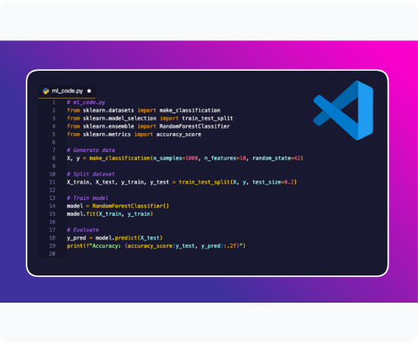
STRATEGIC DATA ACQUISITION
Web Scraping Alternative
We developed a custom Python scraper to extract raw historical records directly from the UK Civil Aviation Authority (CAA), effectively bypassing expensive commercial APIs.
Data Synthesis
Years of fragmented monthly reports (2022–2025) were merged into a unified longitudinal dataset, providing a robust foundation for time-series analysis.

Slide 7






FEATURE ENGINEERING & TARGET ADAPTATION
Dataset Augmentation
Target Refinement
Exp. Architecture
Adapted model variables (Delay vs. Cancellation) to align precisely with the specific distribution of extracted CAA data.
Iterative testing of multiple models with flexible categorical encoding for high-accuracy route predictability.
Generation of temporal features including seasonality, weekday patterns, and peak hour distributions to overcome raw data limitations.

Slide 8
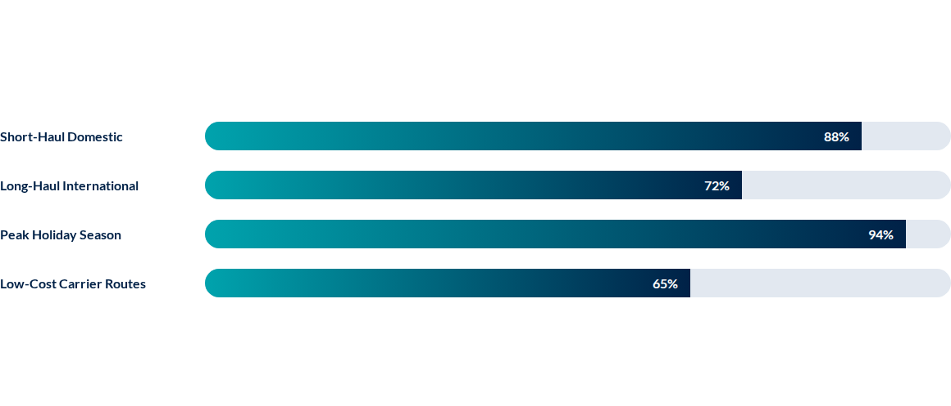
EDA: OPERATIONAL RISK DRIVERS
Predictability score across different route categories (based on historical correlation analysis):
*Data synthesized from merged CAA reports (2022-2025) for EDA validation.

Slide 9
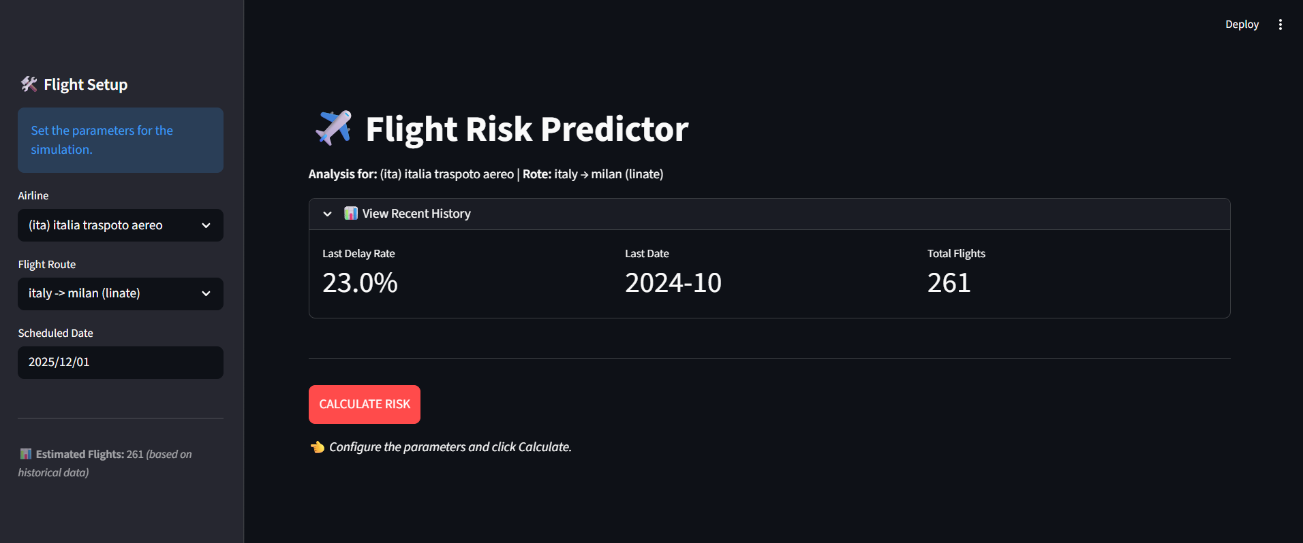
OUTPUT & IMPACT
Our output consists of two specialized models that predict delay and cancellation risks based on the historical performance of specific airline routes during the month of travel. These insights are delivered through a Streamlit application, allowing users to input their flight details and receive an immediate operational risk score.

Slide 10
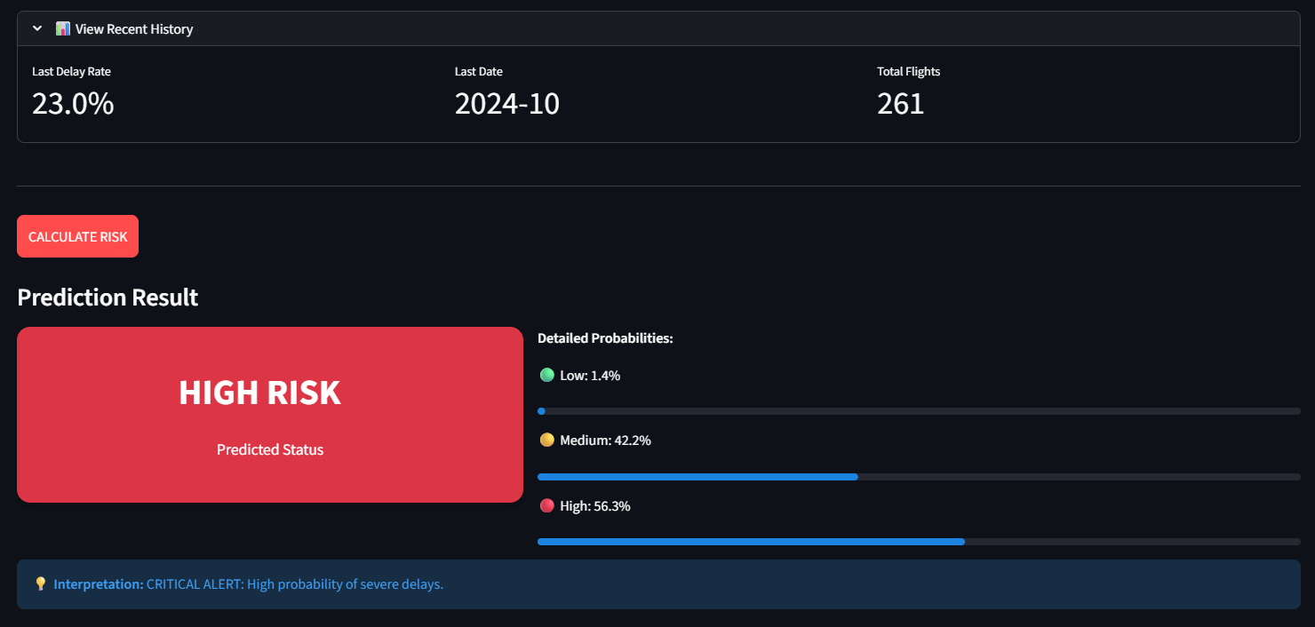
PREDICTIVE INTELLIGENCE OUTPUT
Delay Prediction: Estimated based on route history and temporal features.
Cancellation Risk: Specialized scoring for airline operational stability.

Slide 11

THE VALUE PROPOSITION
Reduce Disruptions: Empowers business travelers to avoid high-risk routes proactively.
Summary
Optimize Insurance: Drives sales through targeted, data-backed risk recommendations.
This solution bridges the gap between high-cost data and the everyday consumer’s need for certainty, creating a major opportunity for operational efficiency and revenue growth.
Bridge the Data Gap: Connects low-cost public data with high-value consumer needs for certainty.

Slide 12


THANK YOU
Predicting the future of flight risk.
Flight Risk | Analytics & Data Science Solution

